Slide 1



Buffet Decoration Ordering System
Presenters:
Abrar Fauzi
Razi Dallasheh
Supervisor:
Zeev Brazily

Slide 2



Introduction
In the dynamic realm of event planning, the visual aesthetics play a pivotal role in creating memorable experiences. The Buffet Decoration Project presents an innovative solution to streamline and elevate the process of selecting and ordering buffet decorations .

Slide 3
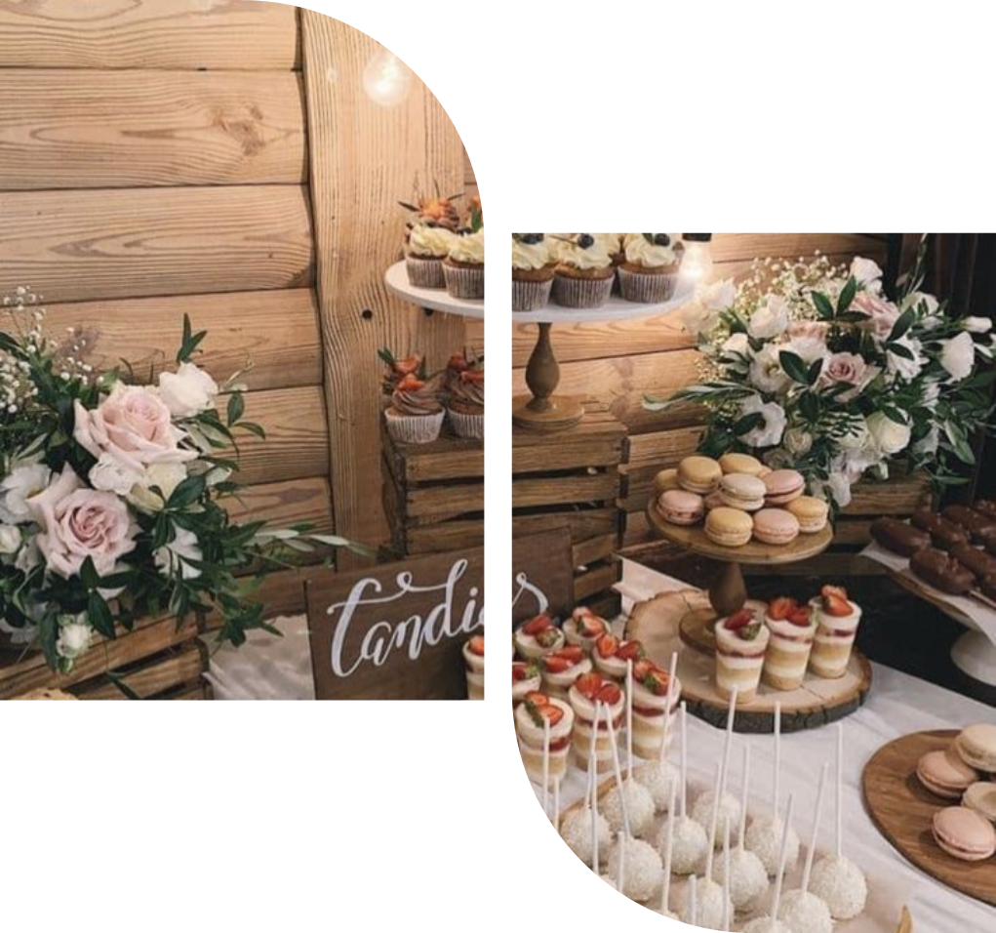
What is the problem?
The problem at hand is the cumbersome and time-consuming process of arranging buffet decorations and selecting flower bouquets for events. Clients often struggle with limited options, manual coordination, and a lack of visualization tools, hindering their ability to curate a cohesive and personalized event aesthetic.

Slide 4

Proposed Solution
introducing an innovative Buffet Decorations Ordering System
integrating a user-friendly interface, visual representation tools, and a comprehensive range of options.

Slide 5
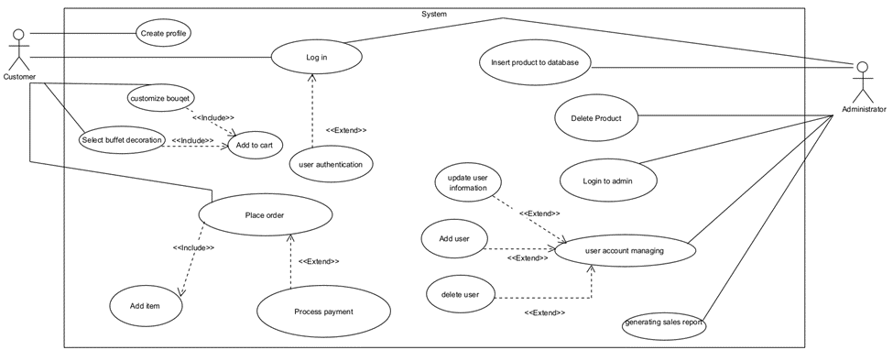
Use Case

Slide 6
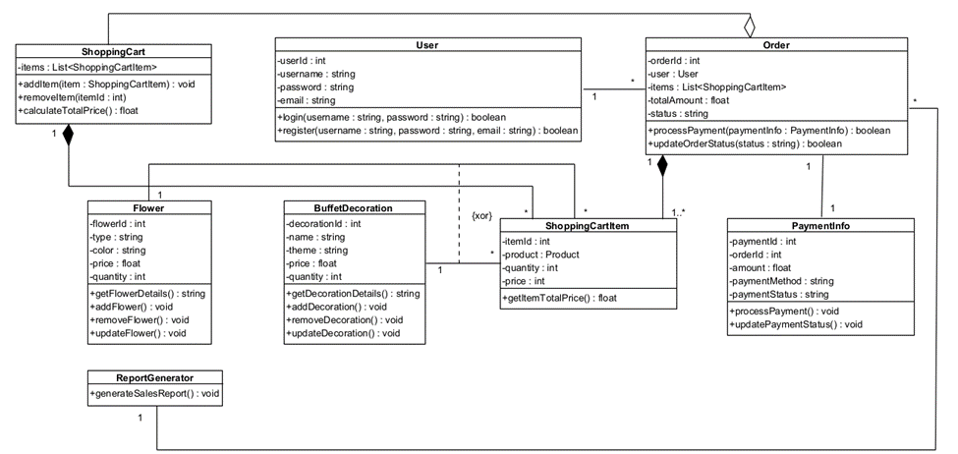
Class Diagram

Slide 7

User Interface
Overall Theme and Layout:
The user interface (UI) for our web application is designed to be clean, modern, and intuitive, facilitating a seamless and enjoyable experience for users planning event decorations. The color palette is soft and welcoming, incorporating pastel shades that echo the aesthetic of floral arrangements and elegant event settings.

Slide 8
User Interface
Navigation Bar:
At the top of the page, a navigation bar allows easy access to different sections of the application: Design, Flowers, Colors, Buffet, Decor, and Checkout. This straightforward navigation ensures that users can quickly switch between different customization options without losing their progress.

Slide 9
User Interface
Customization Panels: The main feature of the UI is the interactive customization panel located centrally. This panel is divided into multiple sections including:
Flower Types: Users can scroll through a variety of flower types, selecting their favorites based on the event theme.
Colors: A color selection tool allows users to choose hues that match or complement the event’s color scheme.

Slide 10
User Interface
Buffet Decoration Customization:
Adjacent to the flower customization options, there is a section dedicated to buffet decorations. Here, users can select themes and explore decoration items that enhance the aesthetic appeal of their event's dining setup.

Slide 11
User Interface
Shopping Cart and Checkout Process:
The shopping cart is easily accessible via a sidebar that provides a summary of selected items, with options to edit quantities or remove items. The checkout button leads users to a secure payment process where they can enter their payment information and finalize their order with confidence.

Slide 12
User Interface
Interactive Elements:
Throughout the UI, interactive elements like dropdown menus, sliders for quantity, and toggle switches for different decoration options make the customization process engaging and user-friendly. Tooltips and help icons offer additional information and guidance, ensuring users feel supported throughout their design process.

Slide 13
User Interface
Interactive Elements:
Throughout the UI, interactive elements like dropdown menus, sliders for quantity, and toggle switches for different decoration options make the customization process engaging and user-friendly. Tooltips and help icons offer additional information and guidance, ensuring users feel supported throughout their design process.

Slide 14


What do we plan to do and why will it help solve the problem?

Slide 15




propose the development of an intuitive and interactive online platform that facilitates the entire process
choosing flower types, colors, and arrangements to selecting buffet decorations that complement the chosen theme
provide a visual preview of their selections, and offer a diverse range of options for customization
The solution simplifies the ordering process and enhances the overall event planning experience.

Slide 16
Testing
Functionality Testing
Performance Testing
Security Testing

Slide 17
Testing Method
Automated and Manual Testing
Load
Testing
Beta
Testing

Slide 18
Expected Challenges
•User Diversity: Designing an interface that caters effectively to users with varying degrees of technological proficiency.
•Load Management: Maintaining performance during peak usage, especially during major event seasons.
•Security: Protecting against data breaches, especially given the financial transactions involved.

Slide 19
Expected Results
•High Reliability and User Satisfaction: Expecting positive feedback on user interface design and overall functionality.
•Scalability Confirmation: The platform should handle increased loads without significant performance degradation.
•Security Robustness: No critical security vulnerabilities should be found.

Slide 20

Thanks For Listening

